Slide 1

Development of Weir-Wall Contour-Matching
PIT Tag Antennas for John Day Dam Adult Ladders
PTAGIS Field Office
Kennewick, Washington
April 2015

Slide 2
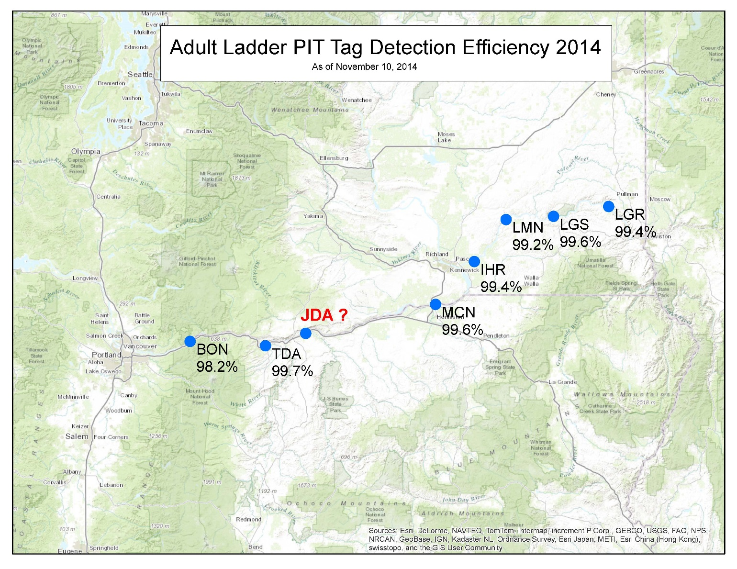
Background
Fisheries researchers in the Columbia River Basin (CRB) recognized a need for PIT tag detection in the North and South ladders at John Day Dam. John Day is the last dam in the Lower CRB without adult PIT tag detection.
Note the near 100% PIT tag detection efficiencies at the Columbia River Basin locations.
Notes:
.

Slide 3
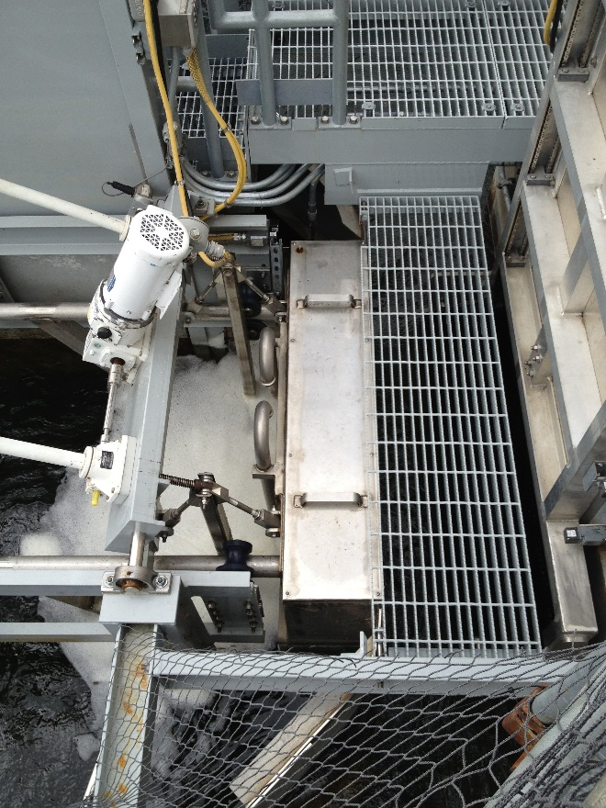
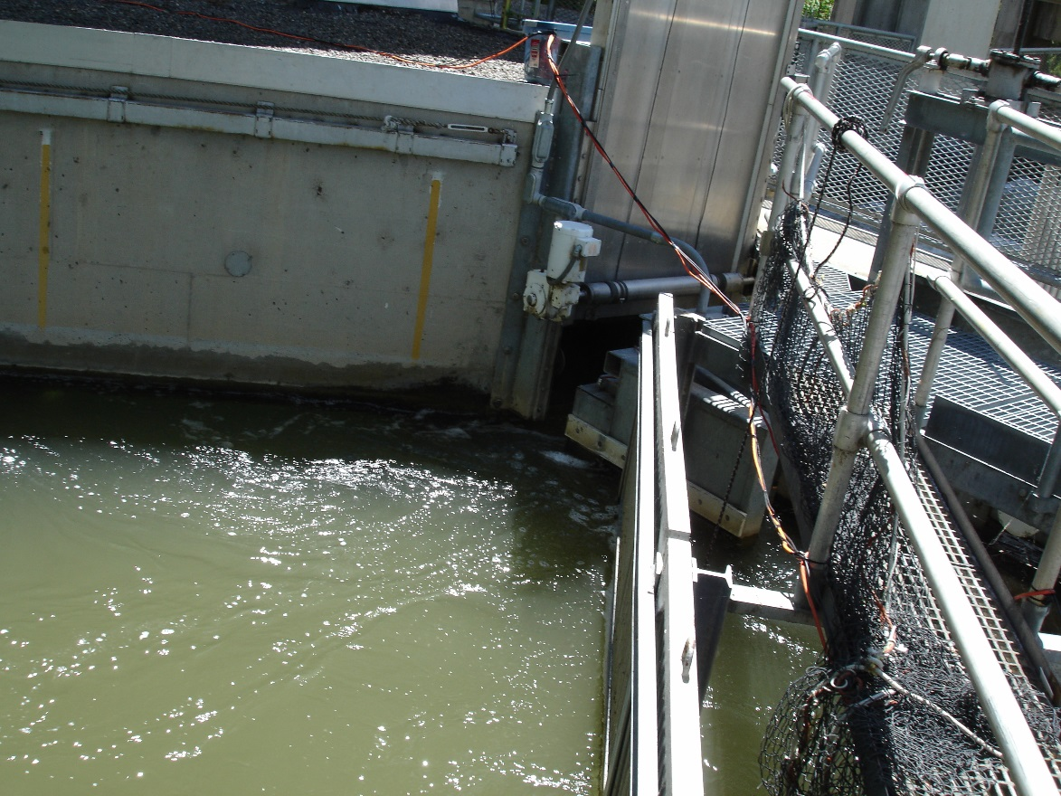
Background
After several visits to John Day, it was determined the existing infrastructure surrounding the North and South counting window locations would require extensive renovation and would not be cost effective to install PIT tag antennas.
John Day North Counting Window
John Day South Counting Window
Notes:
.

Slide 4
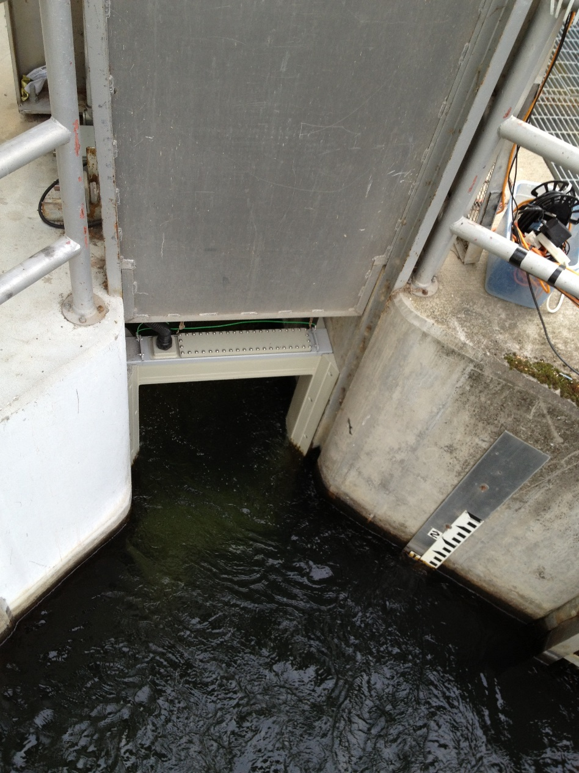
Background
In 2012, PSMFC successfully developed a thin body ferrite tile antenna in the PSMFC Kennewick Lab.
In 2013-14, these thin body style antennas were successfully installed in counting window locations at The Dalles, Little Goose and Lower Monumental dams.
Notes:
.

Slide 5
Background
After a complete review of all other installation options, the overflow and orifice weirs were chosen as the best target locations.
Antenna development surrounding the overflow and orifice weirs was initiated.
In November 2014 a design was proposed that would have raised the water level in the weir. Today we present the “Weir-Wall Contour-Matching PIT Tag Antennas” which will not raise the water levels.
The following slide contains the conceptual drawing demonstrating how four antennas would be installed on any existing overflow weir wall.
Notes:
.

Slide 6
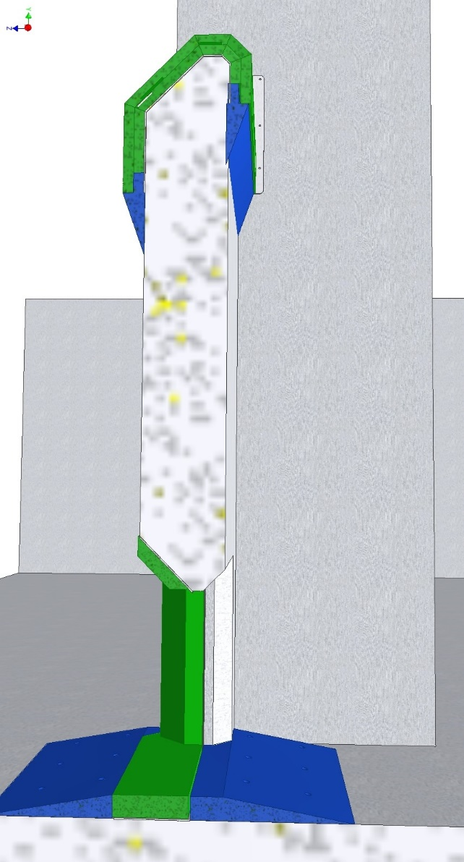
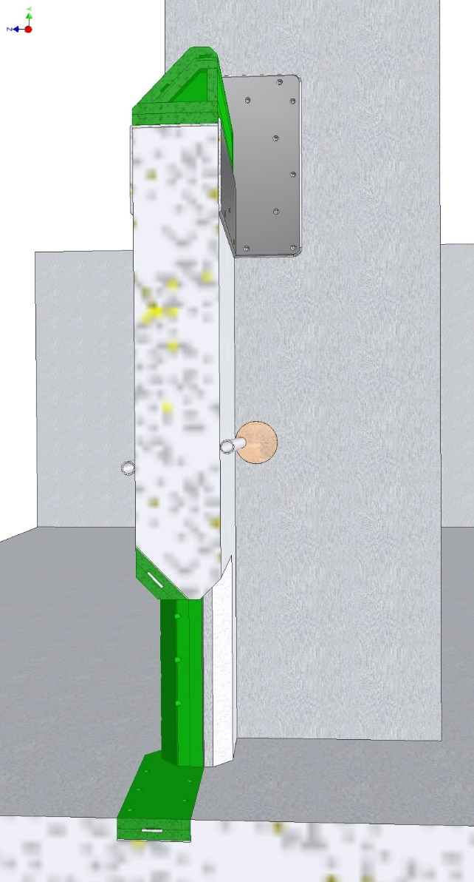
Fish Ladder Concrete Work Side View Cutaway
No-cut Overflow Antenna
(previously presented)
Weir-Wall Overflow-Contour PIT Tag Antennas installed.

Slide 7
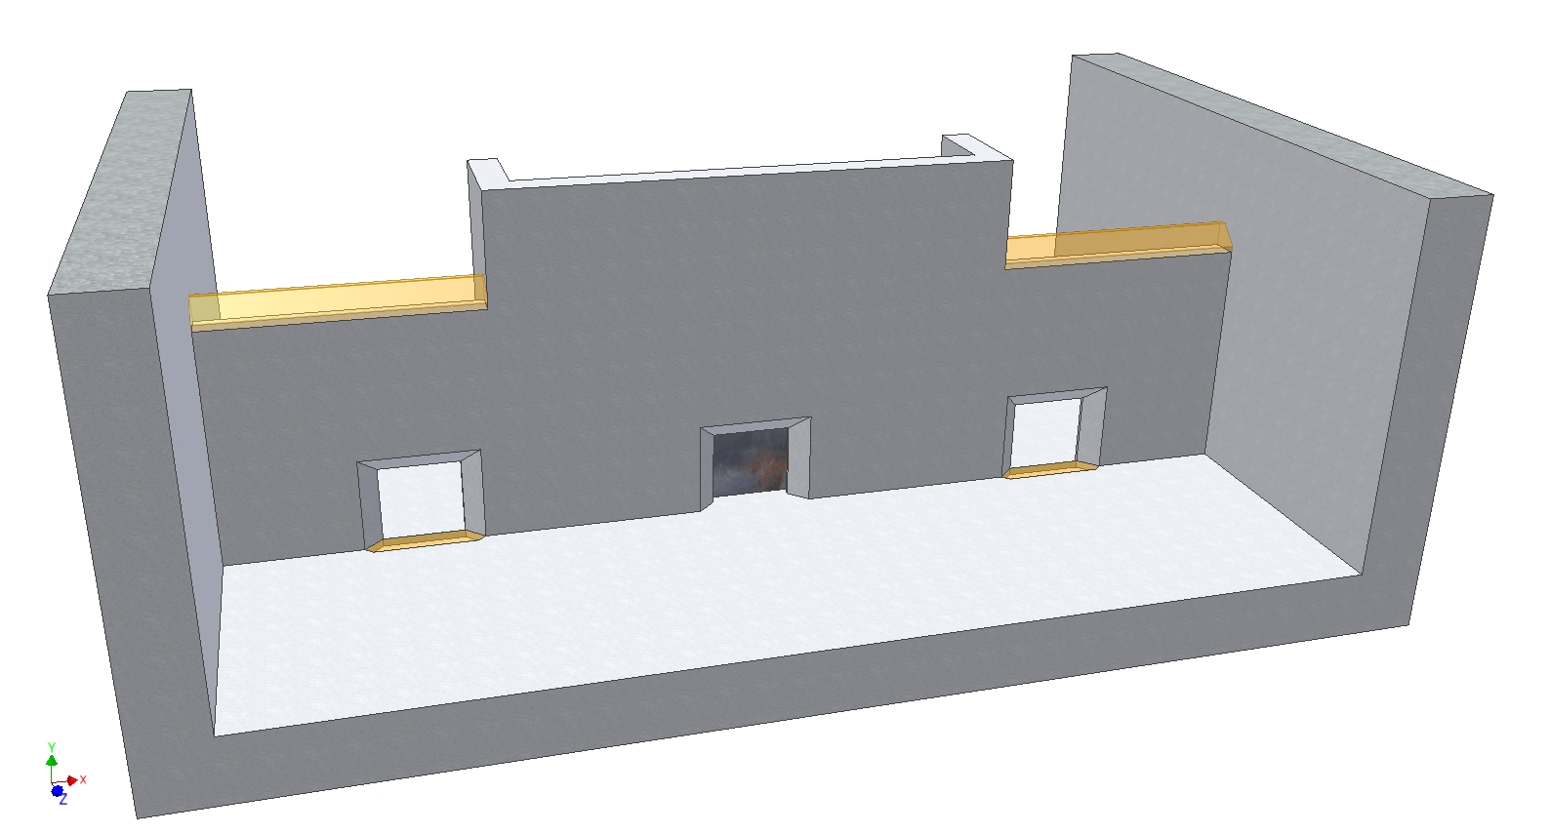
Fish Ladder Concrete Work
Minimal concrete cutting would be required.
Concrete to be removed is shown in translucent orange.

Slide 8
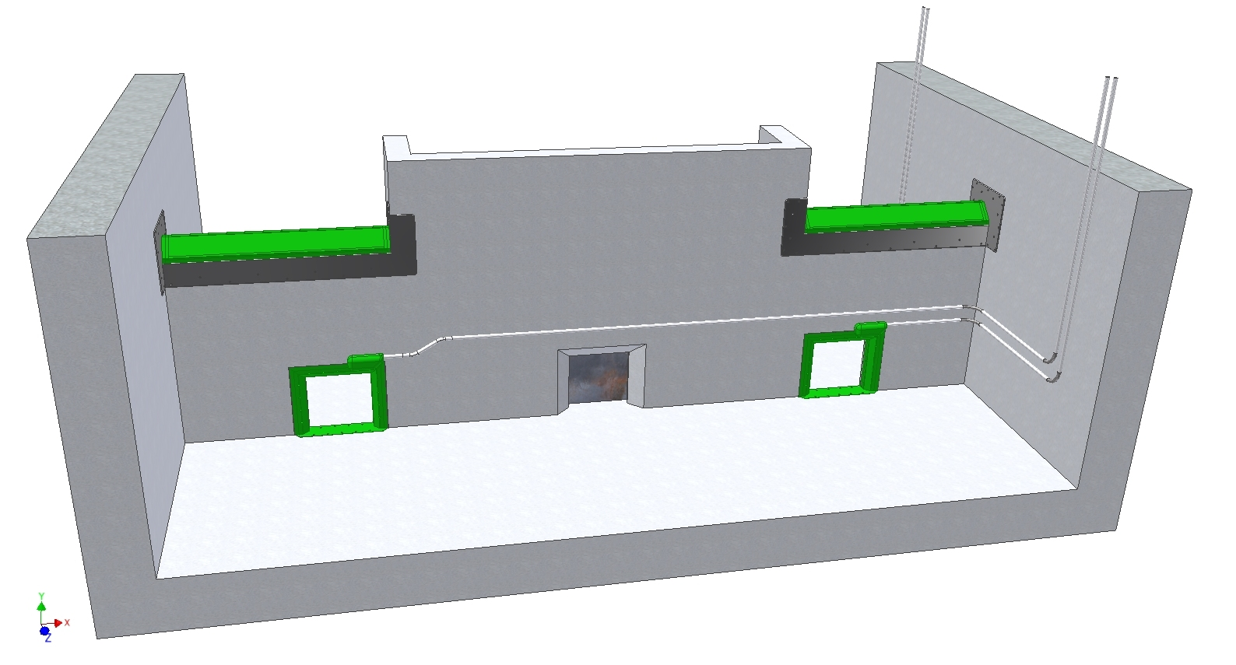
Conceptual Drawing of Proposed Overflow and Orifice Antennas Antennas are one-piece assemblies for short installation time.
Overflow antenna
Orifice is blocked, not a passage route
Orifice Antenna

Slide 9
In the Summer of 2014, A Thin Body Overflow Antenna was Developed by Kennewick PSMFC Staff and Tested at the Pasco NOAA Facility.
Antenna Benefits:
Antenna is a Ferrite Tile Thin Body Flat-Plate design.
Installation, with minimal concrete cutting, provides no change in weir water levels.
Antenna is contoured to match the geometry of the weirs overflow notch.
Designed to fit the entire width of the weir wall notch.
Antenna design is effectively immune to ferrous materials that may be in the weir notch and adjacent walls.

Slide 10
Thin Body Overflow Antenna Developed and Tested
Antenna Benefits:
Minimal hydraulic disruption.
Ease of installation. Drop in bolt on design.
Antenna and shield are pre-fabricated and are designed with minimal site fabrication required.
Projected detection efficiencies near 100%.
Antenna is constructed of fish friendly highly durable, long lasting copolymer plastic.
Debris passes over the antenna rather than through it.
Only two weir walls will need be to outfitted per ladder.

Slide 11
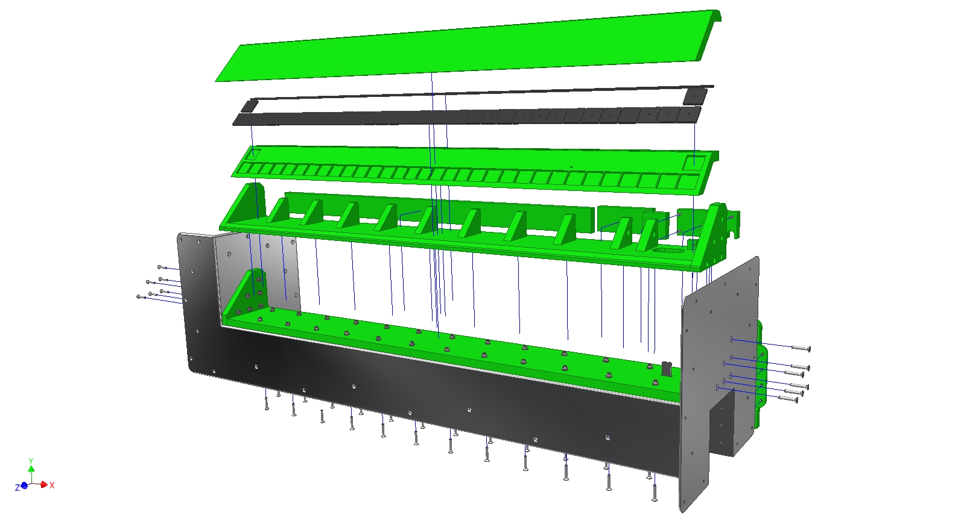
Exploded View Weir-Wall Contour-Matching PIT Tag Antenna
Shield and antenna to be delivered as one complete assembly.
Designed to copy existing overflow notch shape.
Aluminum antenna shield mounted on square cut concrete to maintain weir water levels.
Contour-Matching Top
(Embedded antenna coil)
Ferrite Tiles
Inner Shell
(Embedded ferrite tiles)
Support Structure
(Electronics cavities)
Aluminum Shield
(Electrical isolation & physical mounting)

Slide 12
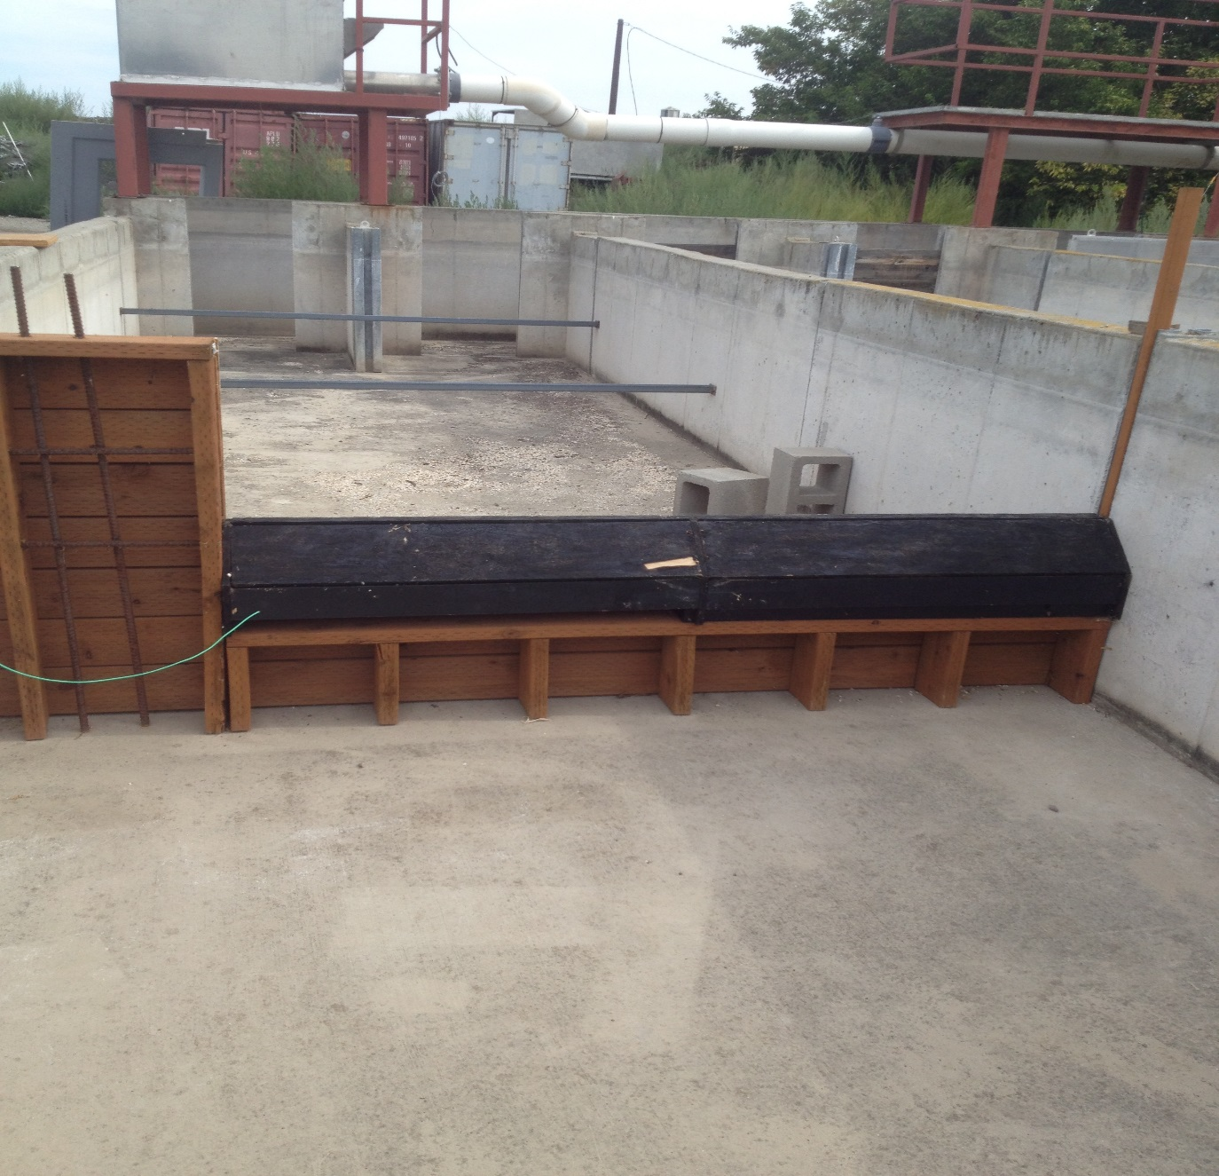
Mock up of John Day Overflow Weir at NOAA test facility in Pasco, WA
A mock weir wall was constructed to simulate a portion of the John Day ladder dimensions.
Rebar was installed under the overflow cap and adjacent wall to simulate the construction of the real ladder walls.
6 Ft span
Rebar
Ground wire attached to rebar in side top of weir
Top of overflow weir

Slide 13
In Water Detection Efficiency Testing of Overflow Antenna
Due to the limitations of the water pumps, the raceway had to be filled and then dumped to simulate 12 inches of water over the antenna. 12 inches is the criteria for ladder operation.
Video of read range testing on the prototype overflow antenna was removed from this frame to make this PowerPoint presentation eligible for email transfer. Contact PTAGIS if you would like to see this video.

Slide 14
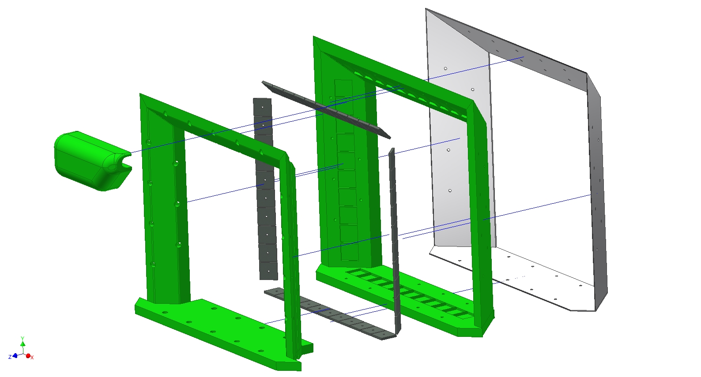
Orifice PIT Tag Antenna
Shield and antenna to be delivered as one complete assembly.
Designed to fit within existing orifice chamfers
Bottom inset flush to floor for lamprey passage and minimal hydraulic disruption
Orifice dimensions unchanged
Outer Shell
(Embedded ferrite tiles)
Inner Shell
(Embedded antenna coil)
Aluminum Shield
Ferrite Tiles
Electronics Cavity

Slide 15
Proposed Orifice Antenna Design
Antenna Benefits:
Antenna is a Ferrite Tile Thin Body Flat-Plate design.
The antenna is approximately 2 inches total thickness.
Antenna maintains the existing 20.75” high x 22” wide orifice dimensions.
Ease of installation. Inserted bolt on design.
Antenna and shield are pre-fabricated and are designed to bolt in place.
Projected detection efficiencies near 100%.
Minimal hydraulic disruption.
Only two weir walls will need be to outfitted per ladder.

Slide 16
PIT tag Installation and Equipment Costs for the John Day South Ladder
Note: Estimate does not include any projected COE engineering support costs.

Slide 17
PIT tag Installation and Equipment Costs for the John Day North Ladder
Note: Estimate does not include any projected COE engineering support costs.

Slide 18
Projected Total Cost of Installation
Possible cost reductions based on several installation factors.
If space within an existing facility can be allocated for PIT Tag Rooms the cost of purchasing free standing buildings would be eliminated.
The electrical infrastructure estimate may vary considerably depending on the locations of the PIT Tag Rooms (in relation to the antennas) and the location of available power.
Depending on the economic feasibility, installation of fiber optic cables from the ladders to the existing Juvenile Fish Facility PIT Tag Room would eliminate the cost of the two additional PIT Tag Rooms.

Slide 19
Questions or Comments?
Gordon Axel 509.547.7518 Gordon.Axel@noaa.gov
Scott Livingston 509.735.2773 Ext. 2 slivingston@psmfc.org
Darren Chase 509.735.2773 Ext. 3 dchase@psmfc.org
Don Warf 509.735.2773 Ext. 1 dlwarf@psmfc.org

